Slide 1

DESIGN BUSINESS BRIDGE
DESIGNING THE FUTURE OF BUSINESS

Slide 2



DESIGN BUSINESS BRIDGE: DESIGNING THE FUTURE OF BUSINESS
“Innovation Is an Invention That Generates Revenue and Profit.”
Organic Revenue Grew in Excess of 6% Annually Since the Adoption of Design Thinking Strategy at Proctor and Gamble
AG Lafley
CEO
Design Business Bridge: Designing The Future of Business HMcGowan 2009

Slide 3
DESIGN BUSINESS BRIDGE: DESIGNING THE FUTURE OF BUSINESS
Business Needs Designers
DESIGNERS CAN INVENT
Empowered With the Tools and Language of Business, Designers Are Uniquely Qualified to INNOVATE
Design Business Bridge: Designing The Future of Business HMcGowan 2009

Slide 4
DESIGN BUSINESS BRIDGE: DESIGNING THE FUTURE OF BUSINESS
Innovation is a three-legged stool:
DESIGN/USER NEEDS
ENGINEERING/TECHNOLOGY
BUSINESS
Designers are uniquely qualified to innovate by applying design thinking to both technology and business
Design Business Bridge: Designing The Future of Business HMcGowan 2009

Slide 5




DESIGN BUSINESS BRIDGE: DESIGNING THE FUTURE OF BUSINESS
INNOVATION: LIGHT BULB IN CONTEXT
DESIGN
Illumination Invented
Engineering/Technology
Infrastructure + Delivery
BUSINESS
Creation + Monetization of Service
Design Business Bridge: Designing The Future of Business HMcGowan 2009

Slide 6


DESIGN BUSINESS BRIDGE: DESIGNING THE FUTURE OF BUSINESS
INNOVATION: DISRUPTION OF THE MUSIC INDUSTRY
DESIGN
Beautiful, Intuitive, Flawless Product
Engineering/Technology
Copyright Protection That Satisfied Industry
.aac
BUSINESS
An Orderly User Friendly Marketplace
Design Business Bridge: Designing The Future of Business HMcGowan 2009

Slide 7
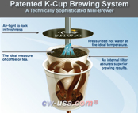


DESIGN BUSINESS BRIDGE: DESIGNING THE FUTURE OF BUSINESS
INNOVATION: COMMODITY PRODUCT
DESIGN
Convenience, Simplicity, Coffee on Demand
Engineering/Technology
Patented Brewing Process
BUSINESS
Built In Reoccurring Revenue, High Switching Costs
Design Business Bridge: Designing The Future of Business HMcGowan 2009

Slide 8
DESIGN BUSINESS BRIDGE: DESIGNING THE FUTURE OF BUSINESS
EXPANDING THE DESIGNER’S IMPACT ACROSS THE INNOVATION SPECTRUM
BUSINESS
BUSINESS
TRADITIONAL DESIGN
Industrial - Fashion - Interior- Architecture - Graphic- Advertising
FINANCE
OFFERING
DELIVERY
PROCESS
DESIGNER
DESIGN MBA BRIDGE
Ten Types of Innovation TM Doblin Group
Design Business Bridge: Designing The Future of Business HMcGowan 2009

Slide 9
DESIGN BUSINESS BRIDGE: DESIGNING THE FUTURE OF BUSINESS
STRUCTURE: MODULES
VALUE
CUSTOMER
DECISIONS
EVALUATION
Business Models
Marketing + Management
Statistics + Operations
Financial Management
INNOVATION
PROCESS OFFERING DELIVERY FINANCE
Each module will run 4 hours a day for 2 weeks
Assessment and refinements will be made between modules, as required, to meet student goals
Design Business Bridge: Designing The Future of Business HMcGowan 2009

Slide 10

DESIGN BUSINESS BRIDGE: DESIGNING THE FUTURE OF BUSINESS
INNOVATION
The Innovation Stream will run through all four modules exploring Apple and Proctor and Gamble.
Students will explore evolutions in their business models, marketing and management procedures, strategies, operations, and finance.
Doblin’s Ten Types of Innovation™ will be referenced throughout the modules as students track the various forms of innovation and synergies with design thinking.
Finance
Offering
Delivery
Process
Design Business Bridge: Designing The Future of Business HMcGowan 2009

Slide 11
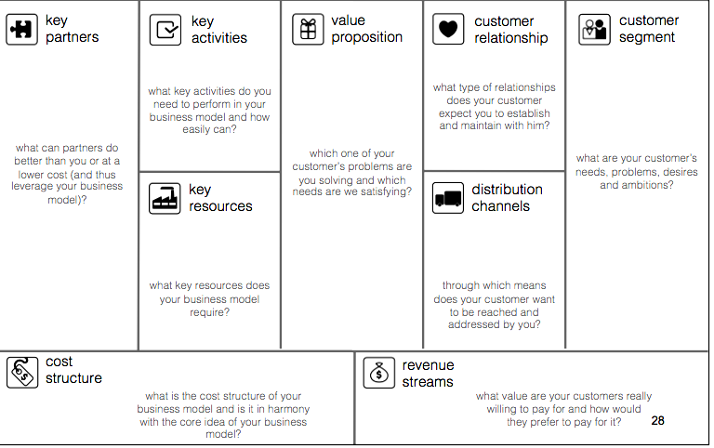
DESIGN BUSINESS BRIDGE: DESIGNING THE FUTURE OF BUSINESS
Bridge Overview Structure: Osterwalder’s Business Model Canvas
INFRASTRUCTURE
OFFER
CUSTOMERS
PROFIT MODEL
Design Business Bridge: Designing The Future of Business HMcGowan 2009
(C) Alex Osterwalder Business Model Innovation Hub

Slide 12
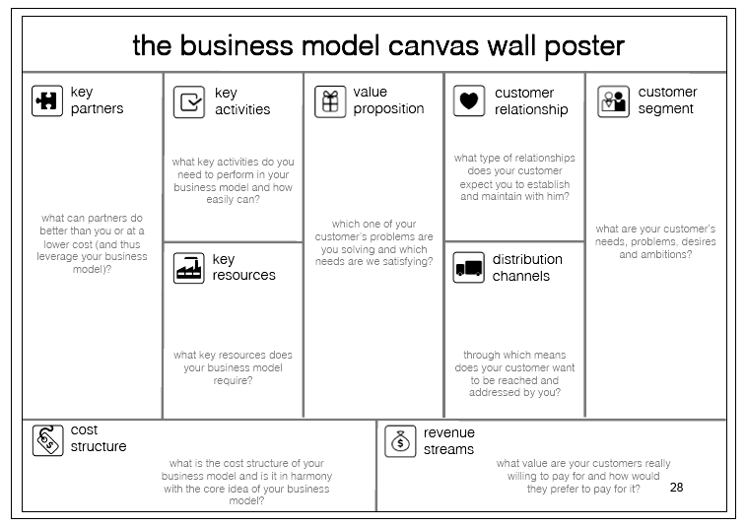
DESIGN BUSINESS BRIDGE: DESIGNING THE FUTURE OF BUSINESS
CUSTOMER
How do you engage the customer in either creating the value proposition or continuous improvement?
What is product positioning and how and why do you do an industry analysis?
What are different strategies around customer acquisition and customer retention?
What is the product or service development process?
Marketing + Management
What is a market segmentation?
What are strategic alliances?
What is a target market?
What is the concept of cannibalization and channel conflict?
What are they key positions in an executive management team, key functions ?
What is a market channel?
What are pricing strategies?
Design Business Bridge: Designing The Future of Business HMcGowan 2009
Business Model Canvas: Business Model Innovation Hub, authors: Yves Pigneur and Alex Osterwalder http://www.businessmodelhub.com/

Slide 13
DESIGN BUSINESS BRIDGE: DESIGNING THE FUTURE OF BUSINESS
DECISIONS
How can I use statistics to understand my offering in the marketplace against alternatives?
How can I use statistics to define customer preferences?
What is knowledge management?
Statistics +
Operations
How can I get and use market feedback?
How can I use statistics to measure a market size?
How can I use data from my suppliers or distributors to inform product development?
How can I use data from my distribution channels?
What does a Chief Operations Officer (COO) do ?
How does your supply chain build your cost structure
Design Business Bridge: Designing The Future of Business HMcGowan 2009

Slide 14
DESIGN BUSINESS BRIDGE: DESIGNING THE FUTURE OF BUSINESS
EVALUATION
How can I understand my revenue growth, decline?
How can I understand the revenue of each customer segment?
What is cost of sales? cost of goods sold?
How can I understand my revenue by customer?
Finance + Economics
How can I partner to reduce my costs?
Other concepts
What is a cash flow statement and why does it matter
What is a balance sheet and how do you read it
What is an income statement and why do I pay attention to profit and loss
Why and how are companies valued
How can I decide how to finance my business?
What is a gross profit margin? Net profit? fixed vs. variable costs?
What are my sales costs and how can I minimize these distribution costs?
Design Business Bridge: Designing The Future of Business HMcGowan 2009

Slide 15
DESIGN BUSINESS BRIDGE: DESIGNING THE FUTURE OF BUSINESS
VALUE
CONCEPTS EXPLORED AND PROBED:
OVERVIEW OF DESIGN PROCESS
CONCEPTUAL MAPPING OF BUSINESS MODELS
CUSTOMER EXPERIENCE
VALUE PROPOSITION
REVENUE + PROFITABILITY MODEL
RESOURCE REQUIREMENTS
KEY PROCESSES + NETWORKS
Business Models
Design Business Bridge: Designing The Future of Business HMcGowan 2009

Slide 16








DESIGN BUSINESS BRIDGE: DESIGNING THE FUTURE OF BUSINESS
BUSINESS MODELS AND CONCEPTS EXPLORED
VALUE MODULE
DESIGN PROCESS, DESIGN THINKING
OWNERSHIP VS. UTILITY, PRODUCT VS. SERVICE
THE REVENUE OPPORTUNITIES IN “FREECONOMICS”
BUILDING NEW MARKETS CO-CREATED VALUE
INNOVATION
BUSINESS MODEL- DISRUPTION OF AN INDUSTRY
USER CENTRIC INNOVATION- CUSTOMER IS BOSS
Design Business Bridge: Designing The Future of Business HMcGowan 2009

Slide 17
DESIGN BUSINESS BRIDGE: DESIGNING THE FUTURE OF BUSINESS
CUSTOMER
CONCEPTS EXPLORED AND PROBED:
PRODUCT DEVELOPMENT + POSITIONING
PROMOTION
BRANDING
CUSTOMER BEHAVIOR
TARGET MARKETING
SOCIAL NETWORKING
Marketing + Management
Design Business Bridge: Designing The Future of Business HMcGowan 2009

Slide 18




DESIGN BUSINESS BRIDGE: DESIGNING THE FUTURE OF BUSINESS
MARKETING + MANAGEMENT CONCEPTS
CUSTOMER MODULE
DESIGN STRATEGY, PRODUCT DEVELOPMENT, POSITIONING
CONSUMER CO-CREATED VALUE
PRODUCT + BRANDING PARTNERSHIPS, CUSTOMER EXPERIENCE
MARKETING THE PROMISE, USE OF SOCIAL NETWORKING
INNOVATION
PRODUCT + MARKETING INNOVATION
INTEGRATING INNOVATION- IDEAS TO MARKET
Design Business Bridge: Designing The Future of Business HMcGowan 2009

Slide 19
DESIGN BUSINESS BRIDGE: DESIGNING THE FUTURE OF BUSINESS
DECISIONS
Concepts Explored and Probed:
Corporate Decision Making
Supply Chain
Statistical Analysis
Quality Control
Statistics + Operations
Design Business Bridge: Designing The Future of Business HMcGowan 2009

Slide 20
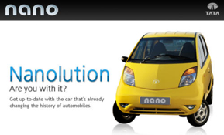



DESIGN BUSINESS BRIDGE: DESIGNING THE FUTURE OF BUSINESS
STATISTICS + OPERATIONS CONCEPTS
DECISIONS MODULE
DESIGN FOR MANUFACTURING, SUPPLY CHAIN EFFICIENCIES
USE OF DATA + STATISTICS IN PRODUCT DEVELOPMENT
MANAGING GLOBAL SUPPLY CHAIN PARTNERS IN PRODUCT + RETAIL
IMPACT OF A FLEXIBLE SUPPLY CHAIN ON RETAIL PRODUCT
INNOVATION
QUALITY AS AN IMPEDIMENT TO INNOVATION
ENABLING INNOVATION STRUCTURE
Design Business Bridge: Designing The Future of Business HMcGowan 2009

Slide 21
DESIGN BUSINESS BRIDGE: DESIGNING THE FUTURE OF BUSINESS
EVALUATION
Concepts Explored and Probed:
Investing + Operations Decisions
Financial Statements
        Income Statement (Profit & Loss)
        Cash Flow Statement (Real Money)
        Balance Sheet (Own and Owe)
Financial Management
Design Business Bridge: Designing The Future of Business HMcGowan 2009

Slide 22





DESIGN BUSINESS BRIDGE: DESIGNING THE FUTURE OF BUSINESS
STATISTICS + OPERATIONS CONCEPTS
FINANCE MODULE
PRICING, VOLUME, OPERATIONAL EFFICIENCIES
FINANCE AND RISING FROM THE BRINK OF BANKRUPTCY
IMPACT OF INNOVATION IN FINANCIAL OFFERINGS TO CUSTOMERS
GLOBAL FINANCE INNOVATIONS: MICROFINANCE
INNOVATION
FINANCIAL IMPACT AND OUTLOOK FROM INNOVATION (IPOD TO IPHONE)
FINANCIAL PROJECTIONS-NEW OFFERINGS (EX: MR CLEAN CAR WASH FRANCHISE)
Design Business Bridge: Designing The Future of Business HMcGowan 2009

Slide 23
DESIGN BUSINESS BRIDGE: DESIGNING THE FUTURE OF BUSINESS
SCHEDULE
VALUE
CUSTOMER
DECISIONS
EVALUATION
Business Models
Marketing + Management:
Statistics + Operations
Financial Management
May 18-May 29
2009
June 1-June 12
2009
June 15-June 26
2009
June 29-July 10
2009
Innovation
Design Business Bridge: Designing The Future of Business HMcGowan 2009

